Slide 1
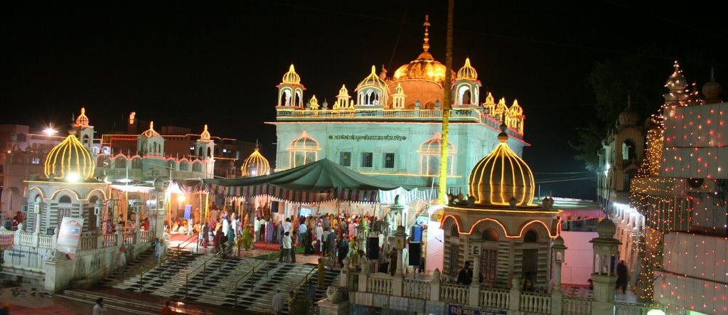
Today in Sikh History – 19 July
Year 1708 , Guru Gobind Singh Ji arrived at Abchal Nagar , Nanded
ABCHAL NAGAR - Nanded city is in South India, on the banks of river Godawari where Guru Gobind Singh left his earthly body on Katak Sudi 5, sammat 1765.

Slide 2
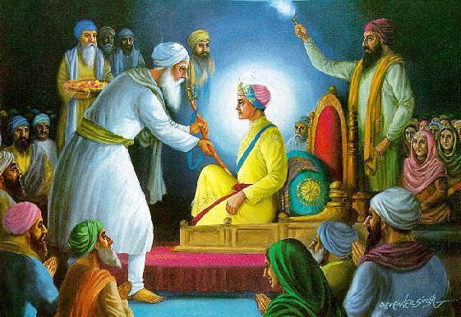
Today in Sikh History – 21 July
1606 : 6th Guru- Sahib Guru Hargobind Sahib Ji wore two Kirpans representing Miri and Piri at Shri Akal Thakht Sahib.
1915 : Sardar Chanan Singh and Ghadri Sikhs were hanged to death in Lahore
1925 : Police and Army of Nabha lifted the seige of Gurudwara Gangsar (made by 10th Guru)

Slide 3

Today in Sikh History – 23rd July

Slide 4
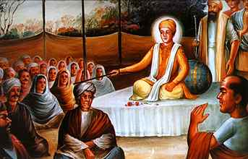
Today in Sikh History – 23rd July

Slide 5
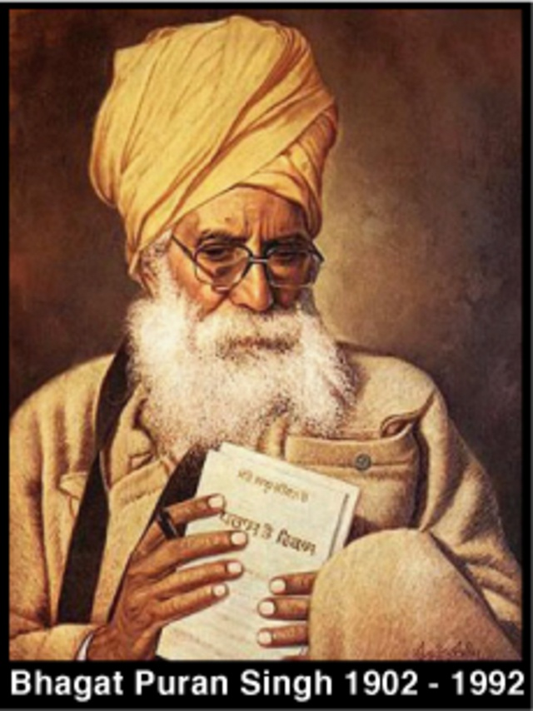
Today in Sikh History – 5 Aug
1992 : Bhagat Puran Singh
Passed Away
Founder of Pingalwara
Helping
individuals who are sick,
Disabled and deserted by
mankind

